Slide 1



Extracting Knowledge from Twitter and the Web
Alan Ritter
Notes:
*********************************************
General goal -> translate text into pictures (easier to follow)
*Use pictures to represent concepts*
-Recurring use throughout talk…

Slide 2
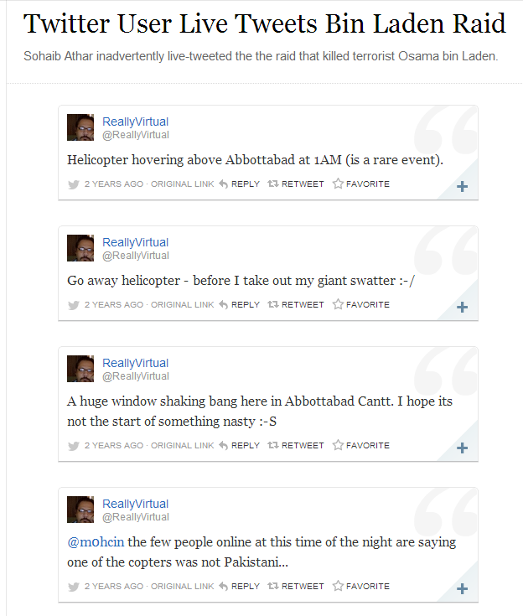
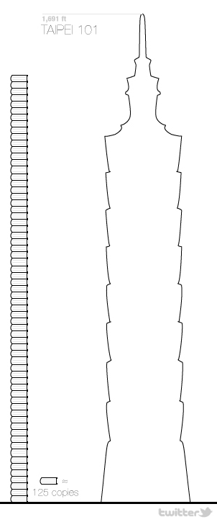
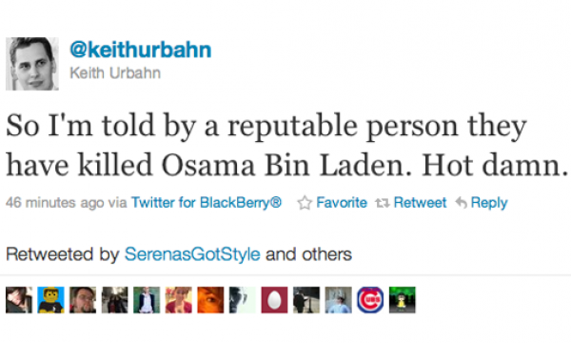


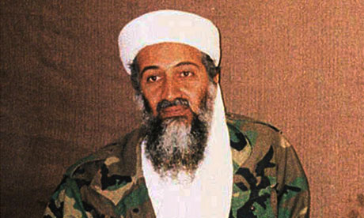




Rise of Informal Text

Slide 3
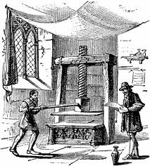

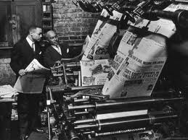
Background: Event Extraction from Newswire
Historically, the most important source of info on current events
Since spread of printing press
Lots of previous work on Newswire
MUC & ACE competitions
Timebank

Slide 4
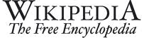

Background: Event Extraction from Newswire
Current Events: good application area for IE
Historical Information -> Difficult to compete
Challenge for NLP Applictions:
News is already well organized…
Notes:
Current events are a really good application area for information extraction.
If our goal is to extract historical or encyclopedic information, then it’s really difficult to compete with manually compiled structured data sources like WP or FB.
But news is also a challenging area for NLP applications. In part because newspapers are already well organized to begin with.
It’s easy to keep up to date with the important news stories each day by reading the paper.
*****************************************
A large portion of previous work on IE and NLP has focused on processing newspaper articles, so I think it’s worth stepping back for a second to ask why that is.
Historically newswire has been the best source of information on current events
Current events are a great application area for NLP
If our goal is to extract historical or encyclopedic information, then it’s very difficult to compete with manually curated structured data sources such as WP or FB.
But newswire is somewhat challenging for NLP applications as well, partly because it’s already quite well organized and edited.
It’s easy to keep up to date on current events by reading the newspaper every day.
***********************************************
A large portion of previous work on IE and NLP has focused on processing newspaper articles, so I think it’s worth taking a moment to reflect on why that is.
-Historically news articles have been the best source of information on current events (really since the spread of the printing press…)
Current events are a really good application area for NLP and IE
-If our goal is to extract encyclopedic knowledge, then it’s really difficult to compete with manually compiled structured data sources such as Wikipedia or Freebase, but if we’re extracting fresh information from news, then we have an opportunity to open up new data-analysis applications.
-One challenge for NLP applications on newswire text, however is that news is already very well organized. It’s fairly easy for a person to keep up to date on important events of the day by reading the newspaper.
********************************************************************************
If we just focus on extracting encyclopedic knowledge (information which is not new) from text, then it’s difficult to compete with manually compiled sources of structured data such as Freebase or Wikipedia.
People are more likely to mention new information using natural language than to fill out structured data forms, so by extracting up-to-date information about current events, we should be able to enable new data-analysis applications
*****************************************************************
Like I mentioned, most previous work on IE / NLP is focused on processing news articles. Since the NLP community is spending so much time working with this data, I think it’s worth stepping back a bit and evaluating why we’ve decided to do this, and whether it makes sense to shift our focus.
Newswire is a natural choice for NLP applications
-Historically newspapers have contained the best source of info on up to date info and current events.
-Clearly NLP can have a big impact by extracting machine processable information on current events
--if we just extract “old” information (that was already known), it’s difficult to compete with manually constructed structured data resources such as Freebase
-
-----------------------------------------------------------------------------------------
Why are we spending so much time working on NLP and IE from newswire? Certainly is a useful domain, but might be time to consider looking at others as well…
Think it’s worth keeping in mind why we’ve chosen this text genre to work on originally, and to evaluate whether it’s necessary to think about other types of text as well…
----------------------------------------------------------------------------------
Of course there has been tons of previous work on extracting events from newswire text.
This makes sense because historically news has been the best source of information on current events.
Examples include the Timebank corpus and the MUC and ACE competitions

Slide 5


Social Media
Competing source of info on current events
Status Messages
Short
Easy to write (even on mobile devices)
Instantly and widely disseminated
Double Edged Sword
Many irrelevant messages
Many redundant messages
Information Overload
Notes:
In the meantime social media has emerged as an important competing source of information on current events.
The status messages written by users of these social networking websites have very different characteristics from news articles.
They are short, easy for anyone to write and are instantly and widely distributed.
For these reasons, social media often contains more up to date information on a wider variety of topics than news.
But this lowering of the barrier to publication is a double-edged sword.
Because these messages are so easy to write, we end up with a lot of irrelevant and redundant information, leading to a situation of information overload.
Again this motivates the need for automatic text processing techniques to aggregate and categorize this disorganized stream of information.
***************************************************
Recently social media has emerged as an important competing source of information on current events. The status messages found on these social networing sites have several unique characteristics as compared with news: they are short, easy for anyone to write even on mobile devices, and are also instantly and widely disseminated. For these reasons Twitter often contains the most up-to-date info on current events.
Lowering the barrier to publication is kind of a double edged sword, however because this also leads to many irrelevant and redundant messages. No person can sit down and read all of the millions of Tweets written every day leading to a situation of information overload and motivating the need for automatic text processing techniques to extract and aggregate the most important information from Twitter.

Slide 6
Noisy Text: Challenges
Lexical Variation (misspellings, abbreviations)
`2m', `2ma', `2mar', `2mara', `2maro', `2marrow', `2mor', `2mora', `2moro', `2morow', `2morr', `2morro', `2morrow', `2moz', `2mr', `2mro', `2mrrw', `2mrw', `2mw', `tmmrw', `tmo', `tmoro', `tmorrow', `tmoz', `tmr', `tmro', `tmrow', `tmrrow', `tmrrw', `tmrw', `tmrww', `tmw', `tomaro', `tomarow', `tomarro', `tomarrow', `tomm', `tommarow', `tommarrow', `tommoro', `tommorow', `tommorrow', `tommorw', `tommrow', `tomo', `tomolo', `tomoro', `tomorow', `tomorro', `tomorrw', `tomoz', `tomrw', `tomz‘
Unreliable Capitalization
“The Hobbit has FINALLY started filming! I cannot wait!”
Unique Grammar
“watchng american dad.”
Notes:
OK, so the noisy, informal text we find on Twitter presents a number of challenges for NLP systems.
First there is a lot of lexical variation; Twitter users are very creative with their use of spelling and abbreviations.
As an example, I ran a distributional word clustering algorithm on a large corpus of tweets, then picked out and cleaned up one of the clusters.
Here you can see there are over 50 different ways people can refer to the word “tomorrow” on twitter. Clearly we aren’t going to see this same kind of lexical variation in news.
Tweets also contain unreliable capitalization. For instance people will often capitalize words simply for emphasis, or leave the whole message lowercased; this is particularly challenging for NE segmentation which relies heavily on capitalization.
Finally tweets have a unique grammar, for instance, users will often drop personal pronouns assuming the subject of the sentence refers to the speaker.
*****************************************************
On the other hand, shallow-syntactic annotation tasks are generally more difficult in Twitter because of their noisy and informal style.
First of all, people are really creative with their use of spelling and abbreviation; as an example, I ran a distributional word clustering algorithm on a large corpus of tweets, then picked out and cleaned up one of the clusters and you can see there are over 50 different ways to refer to the word “tomorrow”. Clearly you wouldn’t see this same kind of lexical variation in grammatical texts such as news articles.
Another problem is unreliable capitalization – People often capitalize words simply for emphasis or don’t capitalize proper nouns. This is a big problem for named entity segmentation which traditionally relies heavily on capitaliation.
Finally tweets have a unique grammar, for example we often see tweets which begin with verbs which isn’t common in news sentences.

Slide 7
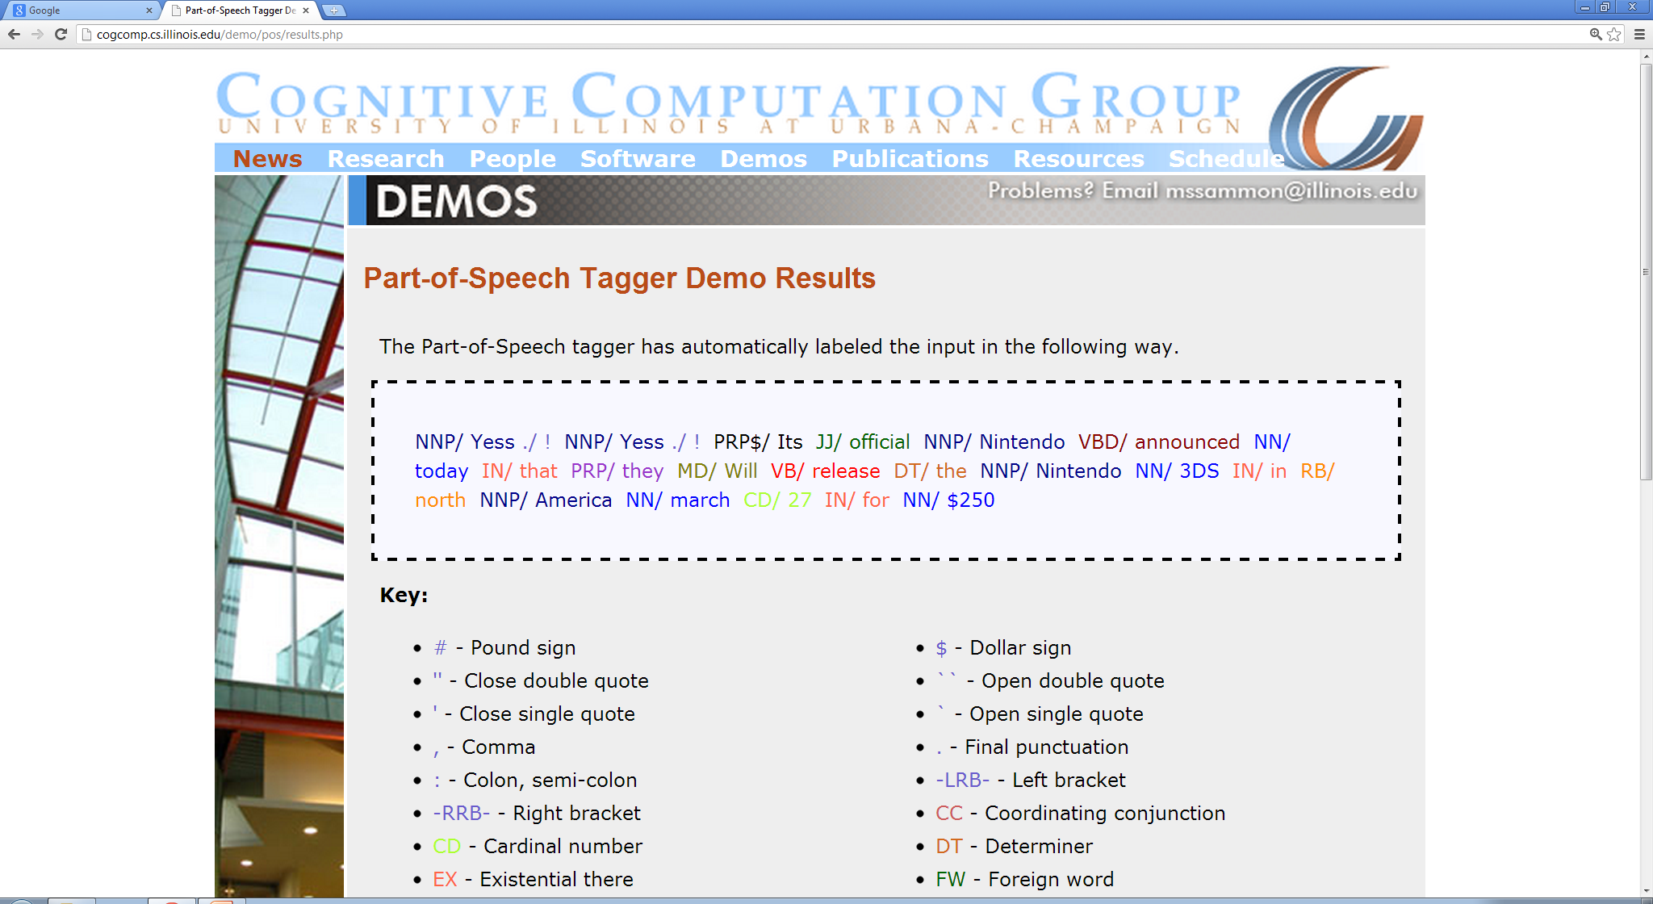
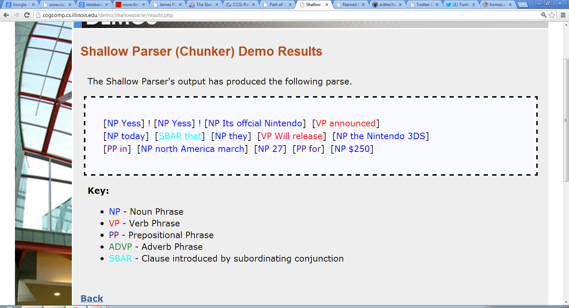
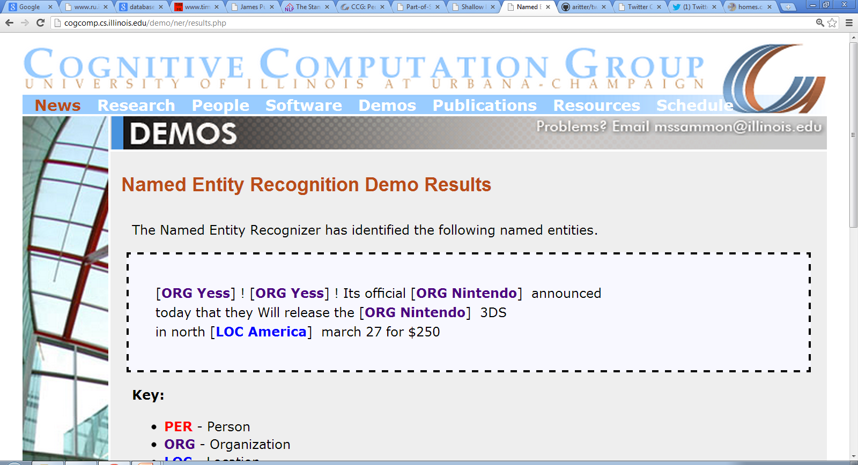
Let’s try NLP on Twitter…
Oops!
“Yess! Yess! Its ofﬁcial Nintendo announced today that they Will release the Nintendo 3DS in north America march 27 for $250”
POS:
Twitter Has Noisy & Unique Style
Chunk:
NER:

Slide 8
Re-Building the NLP Pipeline for Twitter
Syntax
Hypothesis:
Supervised learning is appropriate for syntactic annotation
Unsupervised learning is necessary for semantic processing in open-domain heterogeneous corpora
Annotate corpus of tweets (~2000)
Train in-domain sequence models
Word Clusters / Semi-supervised learning
Lexical Semantics
Supervised
POS
Shallow Parse
Entity
Event
Unsupervised
Named Entity
Classification
Event
Classification
Relation Extraction

Slide 9
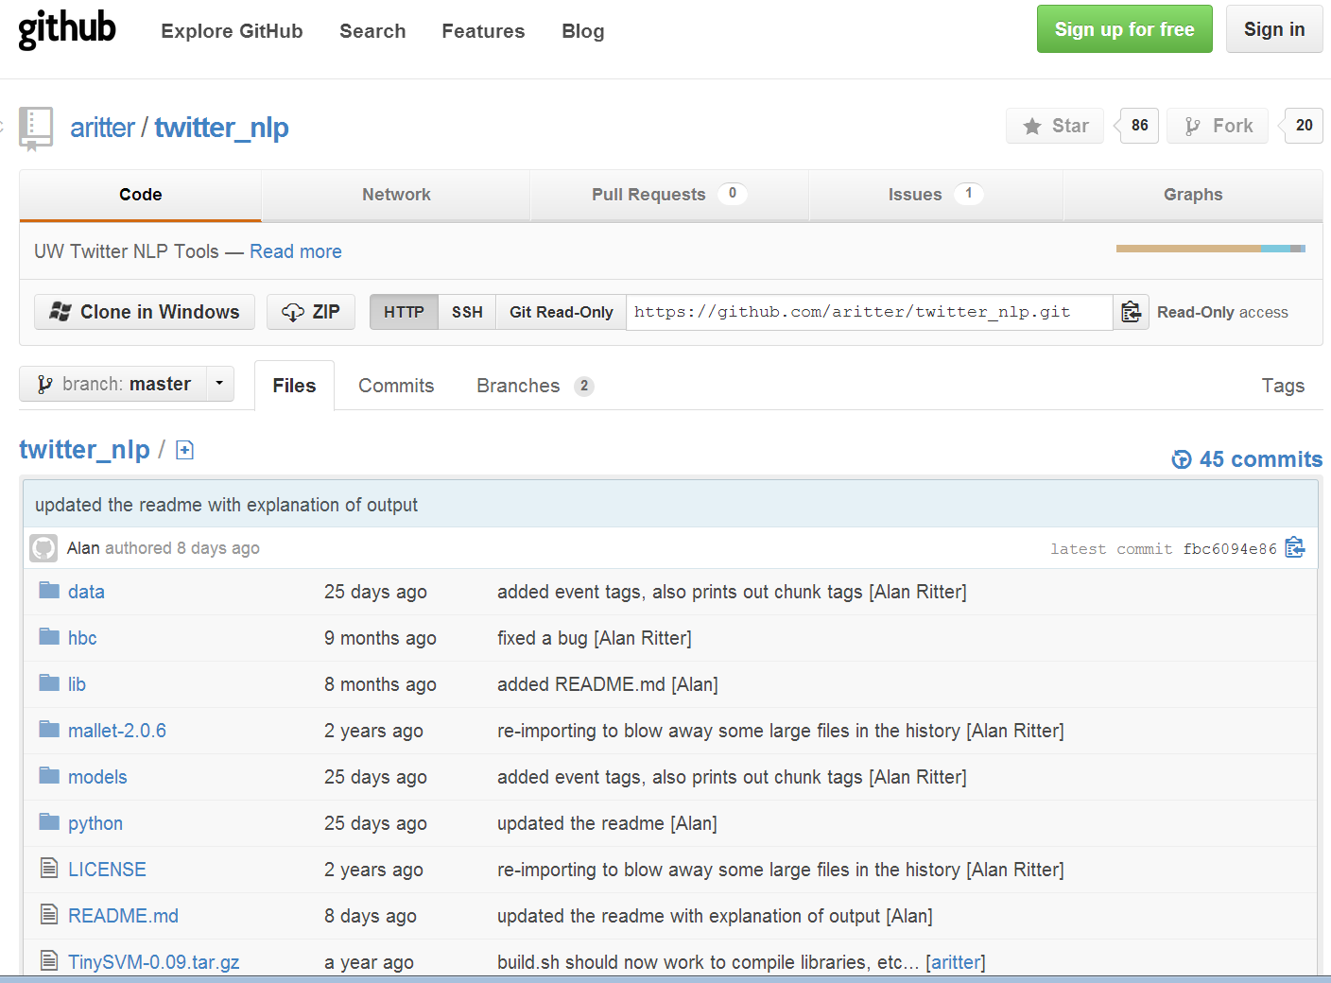
Improved Shallow Syntax on Twitter
[Ritter et. al. EMNLP 2011]

Slide 10
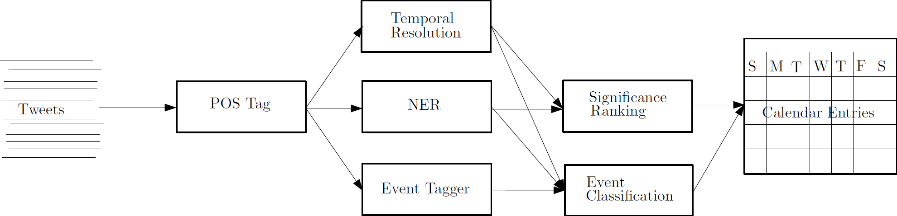

Extracting a Calendar from Twitter
[Ritter et. al. KDD 2012]
“Next Friday”
Tweets processed using in-domain NLP tools
https://github.com/aritter/twitter_nlp
1% sample of global Twitter stream
2 Million / Day
http://statuscalendar.cs.washington.edu/

Slide 11
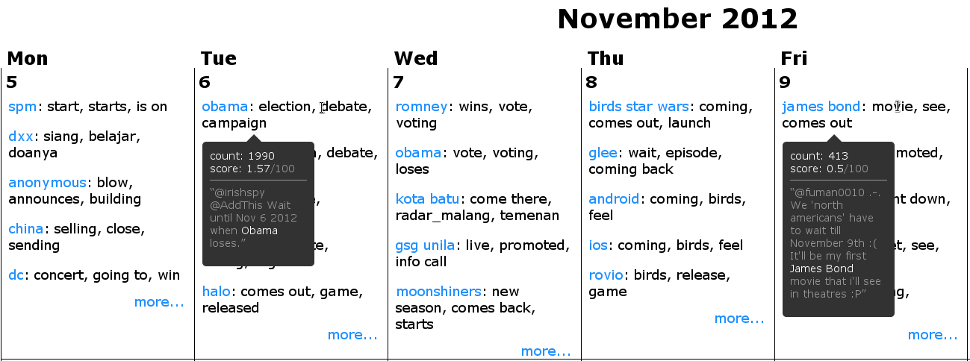
Screenshot from October 26, 2012

Slide 12
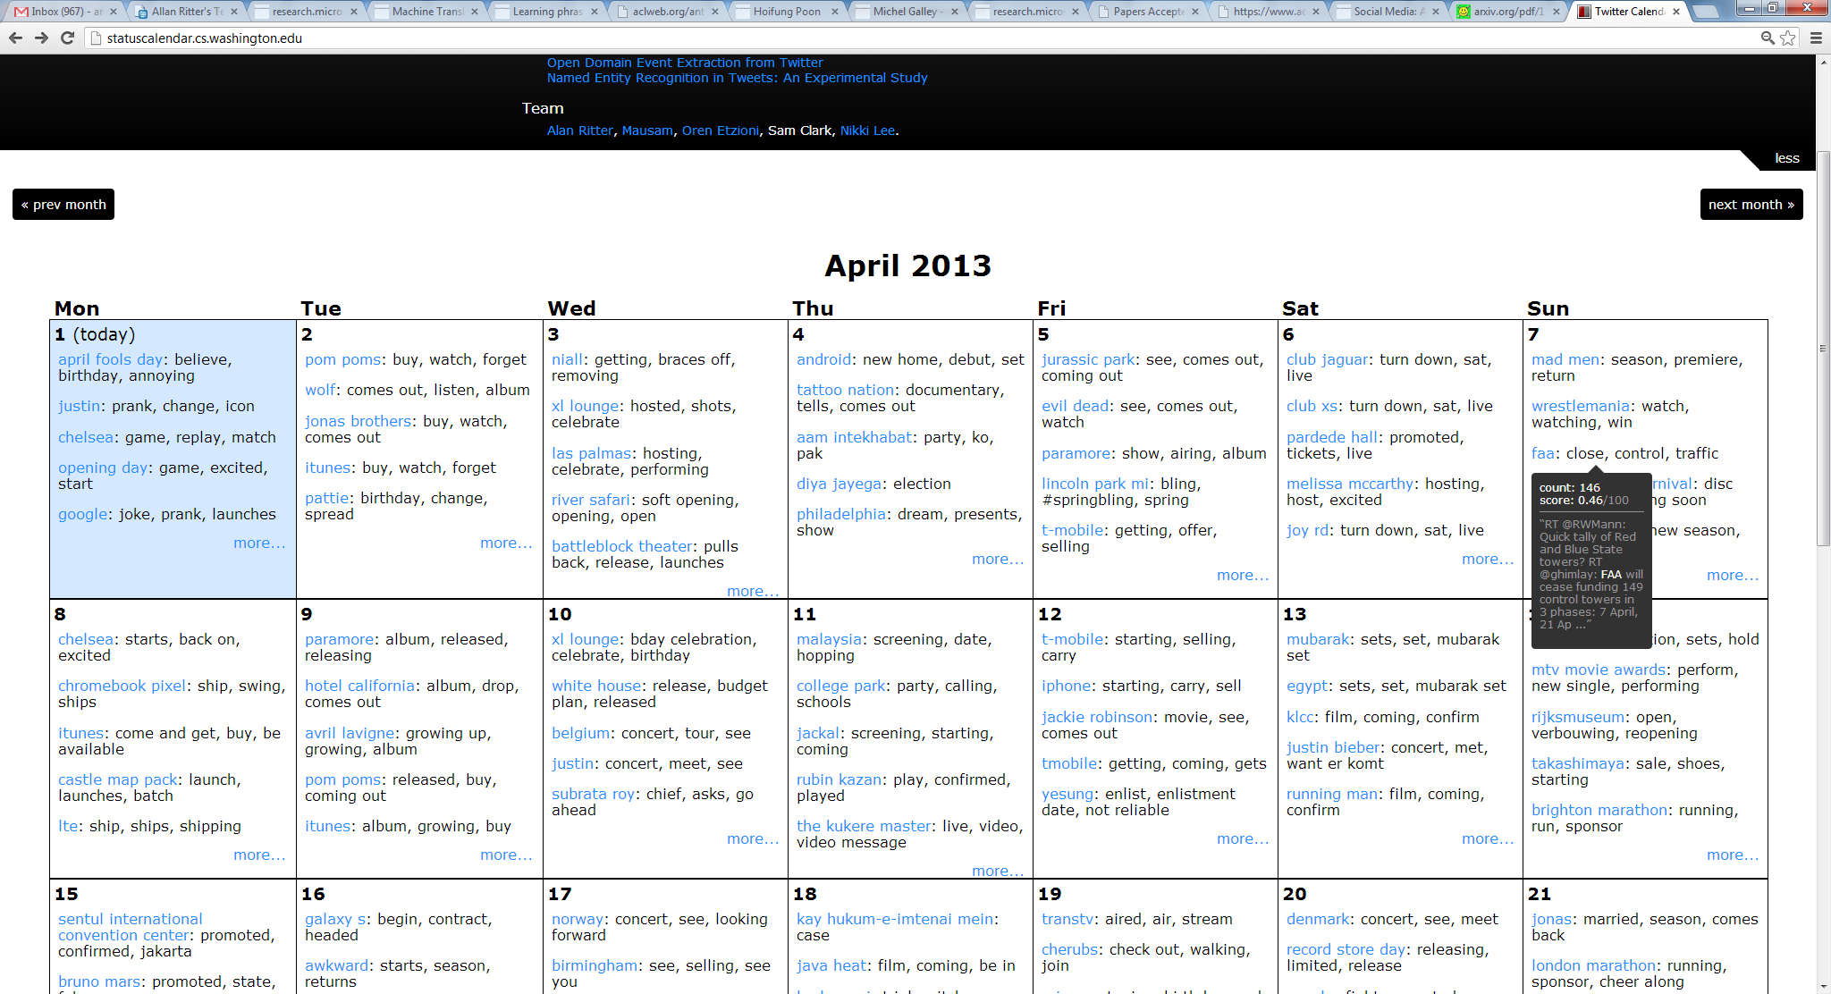

Slide 13
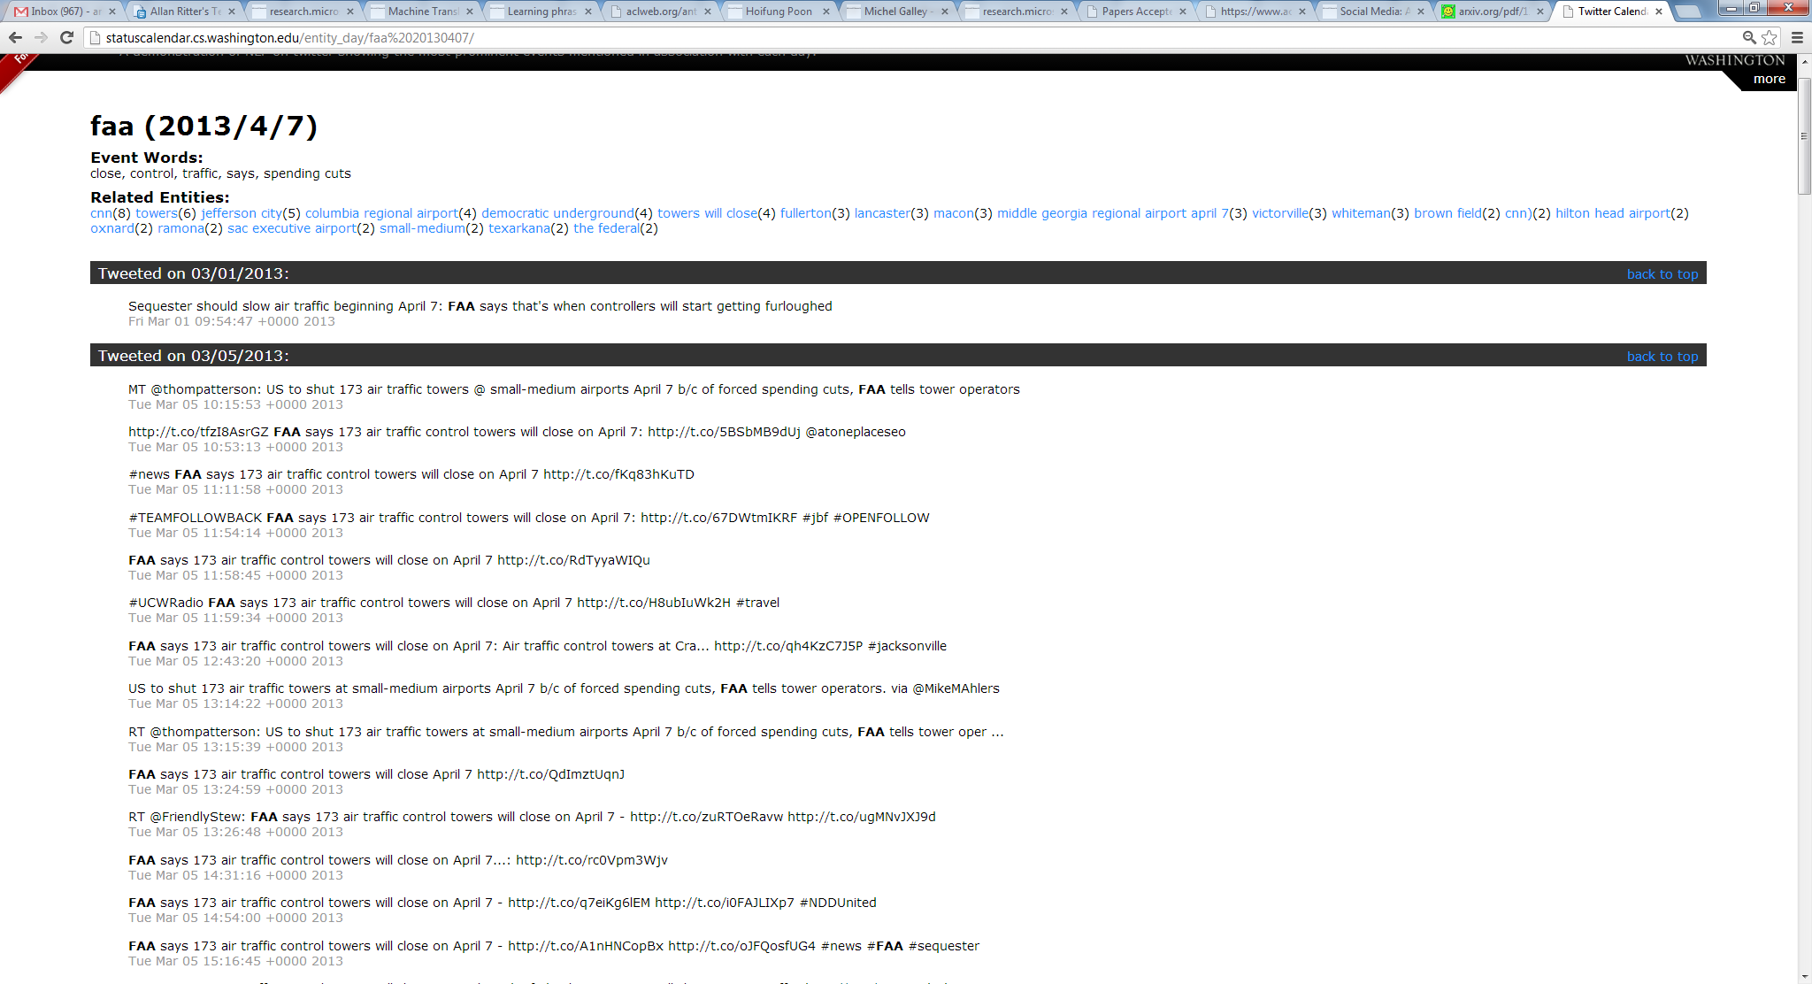

Slide 14
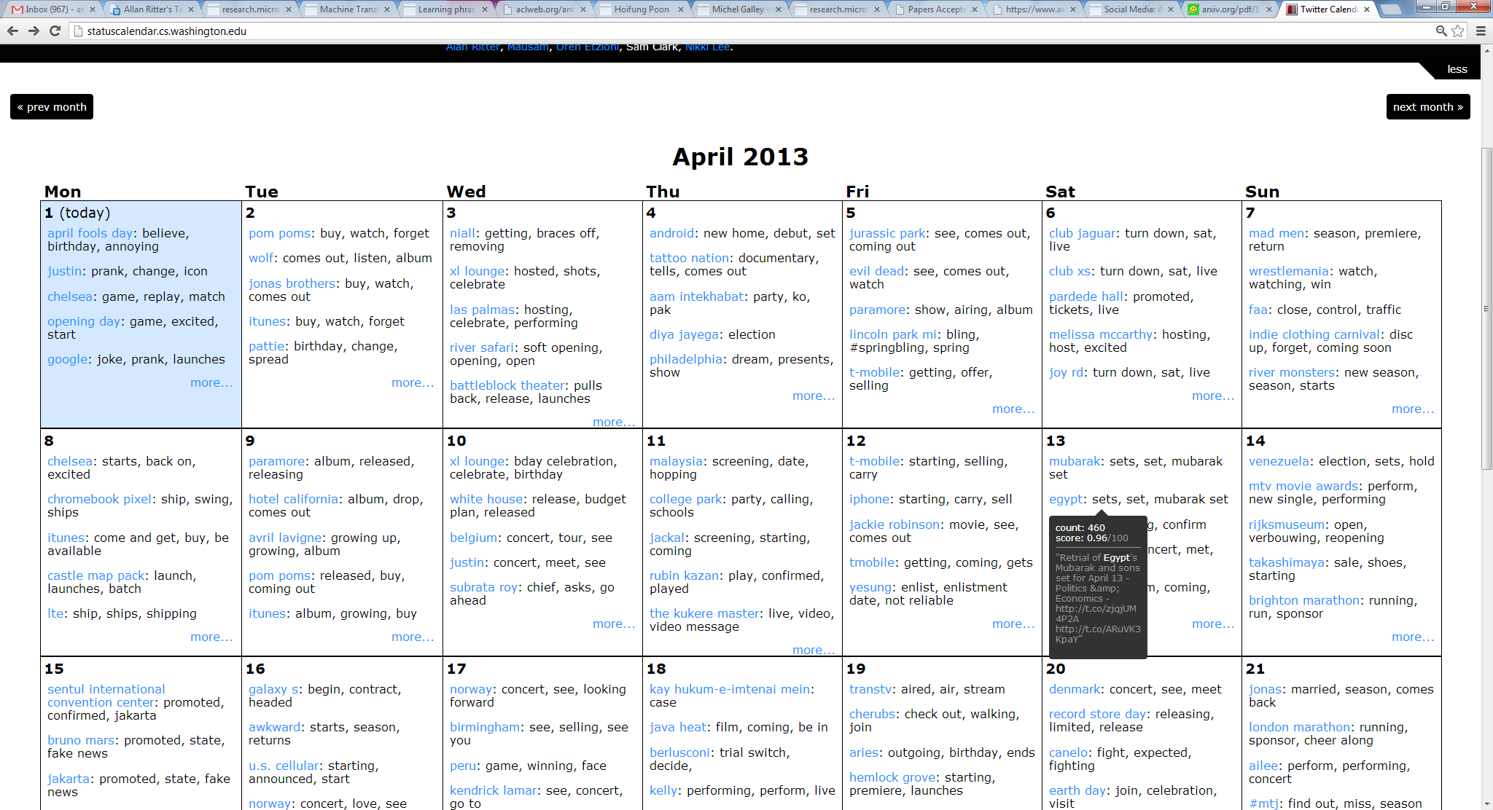

Slide 15
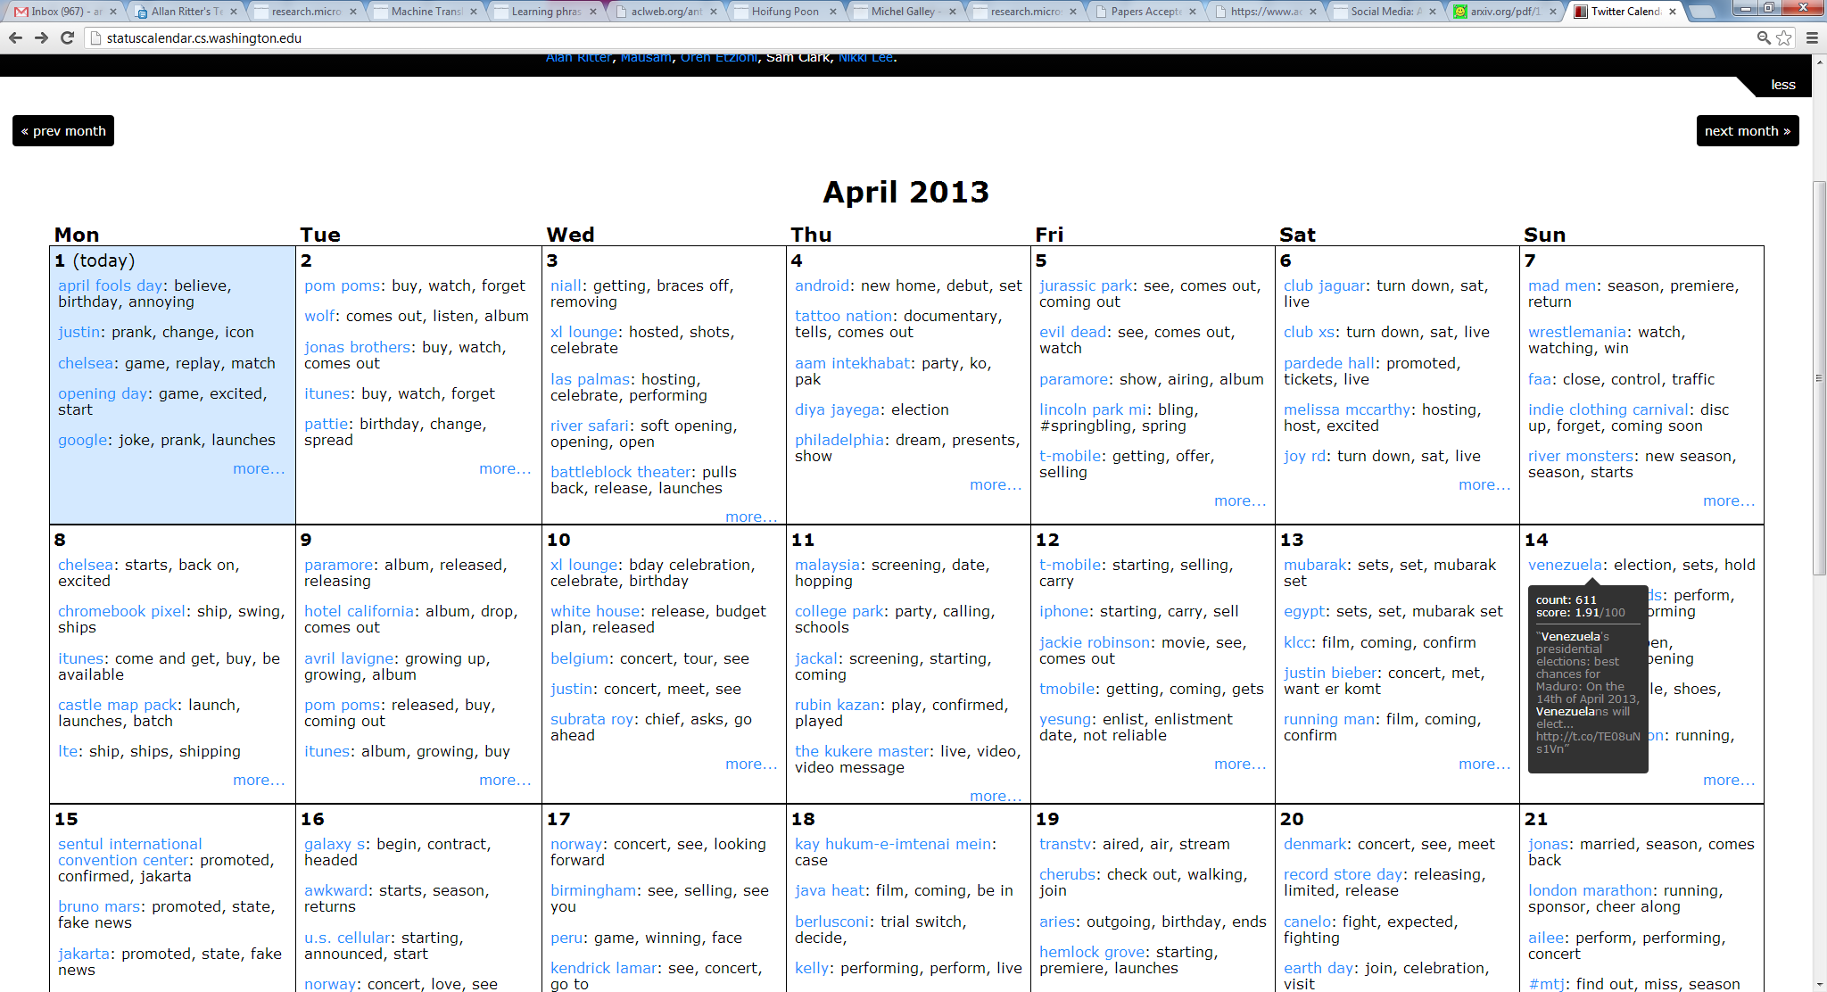

Slide 16

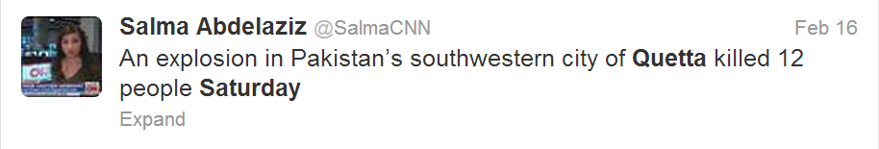
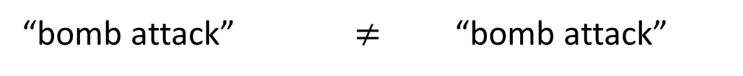
Question: Why does this work?
… 79 people … have been killed in a
bomb attack in … city of Quetta.
At least 79 people are now said to have been killed in a bomb attack in a predominantly Shia Muslim part of the south-western Pakistani city of Quetta.
The blast, which also wounded 180 others, ripped through a crowded market place in an ethnic Hazara area at around 18:00 (13:00) on Saturday.
The blast, which also wounded 180 others, ripped through a crowded market place in an ethnic Hazara area … on Saturday.
A twin suicide bomb attack at a crowded snooker club on 10 January killed ...
“The blast” happened on Saturday
“The blast” == “bomb attack”
“bomb attack” $≠$ “bomb attack”

Slide 17

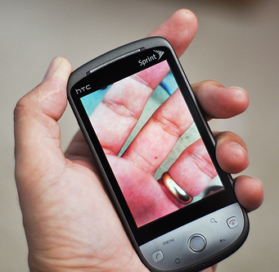

Categorizing Events
…
Sports
Politics
Product Release

Slide 18
Categorizing Events: Challenges
Many Different Types
Not sure what is the right set of types
Set of types might change
Might start talking about different things
Might want to focus on different groups of users

Slide 19
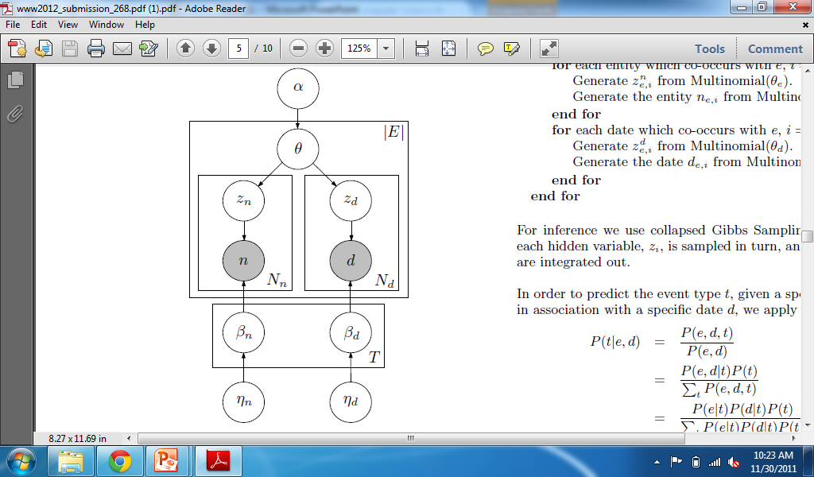
Solution: Unsupervised Event Type Induction
Latent Variable Models
Selectional Preferences
[Ritter et. al. ACL 2010]
Advantages:
Discovers types which match the data
No need to annotate individual events
Don’t need to commit to a specific set of types

Slide 20
Generative Probabilistic Models
Make up a generative story involving:
hidden variables
Probabilities
Apply Bayesian Inference techniques
Gives us reasonable values for hidden variables
Tells us what we want to know

Slide 21
Unsupervised Event Categorization: Generative Story
cheered
win
announce
Apple to announce new iPhone…
Samsung will announce Tuesday…
Obama to announce new plan...
Lakers announce Pau Gasol will…
Microsoft to announce new …
…
Types:
Microsoft 0.04
Samsung 0.02
iPhone 0.01
…
Obama 0.04
Clinton 0.03
Boehner 0.02
…
Ravens 0.04
Lakers 0.03
Pau Gasol 0.02
…
PRODUCT RELEASE
POLITICS
SPORTS

Slide 22
Unsupervised Event Categorization: Generative Story
cheered
win
announce
Apple to announce new iPhone…
Samsung will announce Tuesday…
Obama to announce new plan...
Lakers announce Pau Gasol will…
Microsoft to announce new …
…
…
Types:
Microsoft 0.04
Samsung 0.02
iPhone 0.01
…
Obama 0.04
Clinton 0.03
Boehner 0.02
…
Ravens 0.04
Lakers 0.03
Pau Gasol 0.02
…
PRODUCT RELEASE
POLITICS
SPORTS

Slide 23
Experimental Details…
Gathered about 65M (entity, event, date) tuples
Collapsed Gibbs Sampling
1,000 iterations of burn in
Parallelized sampling (approximation) using MPI
[Newman et. al. 2009]
100 Event Types

Slide 24
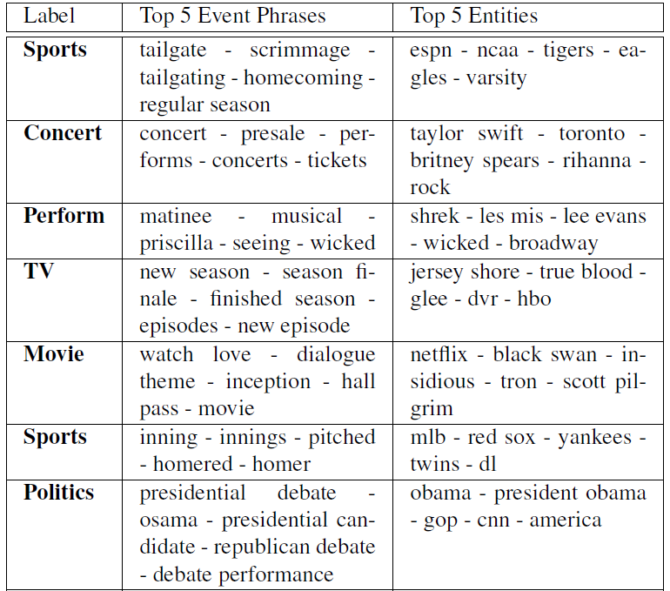

Slide 25
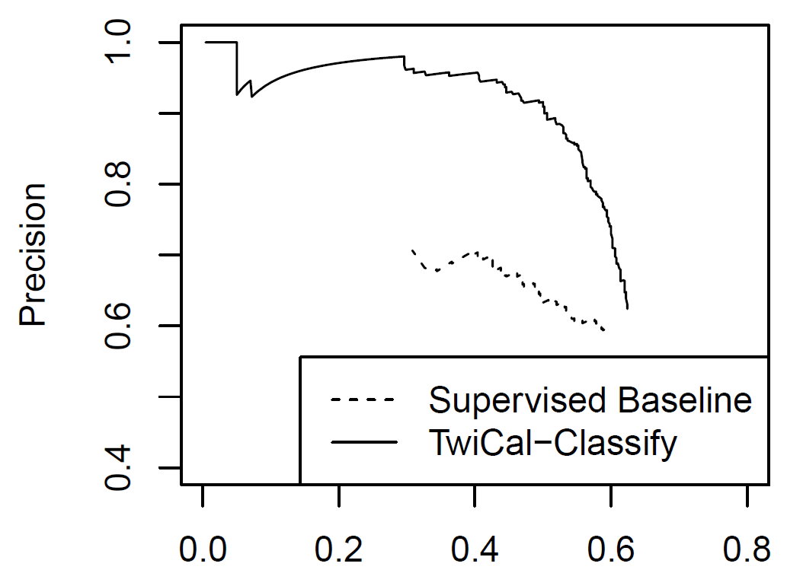
Event Classification Performance

Slide 26
Named Entity Categorization: Exploiting Structured Data
Unsupervised Information Extraction
Advantages:
scale to large unlabeled datasets
agnostic to categories
Question: what if we have structured data?
Freebase

Slide 27
Named Entity Categorization: Challenges
Plethora of distinctive, infrequent types
Bands, Movies, Products, etc…
Very Little training data for these
Can’t simply rely on supervised learning
Very terse (often contain insufficient context)

Slide 28
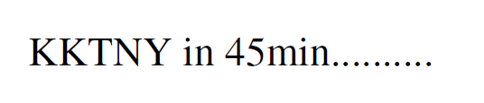
Named Entity Categorization: Challenges
Plethora of distinctive, infrequent types
Bands, Movies, Products, etc…
Very Little training data for these
Can’t simply rely on supervised learning
Very terse (often contain insufficient context)

Slide 29
Weakly Supervised NE Classification
Freebase lists provide a source of supervision
But entities often appear in many different lists, for example “China” could be:
A country
A band
Several people
A film (released in 1943)

Slide 30
Weakly Supervised NE Classification
Freebase lists provide a source of supervision
But entities often appear in many different lists, for example “China” could be:
A country
A band
Several people
A film (released in 1943)
We need Some way to disambiguate

Slide 31
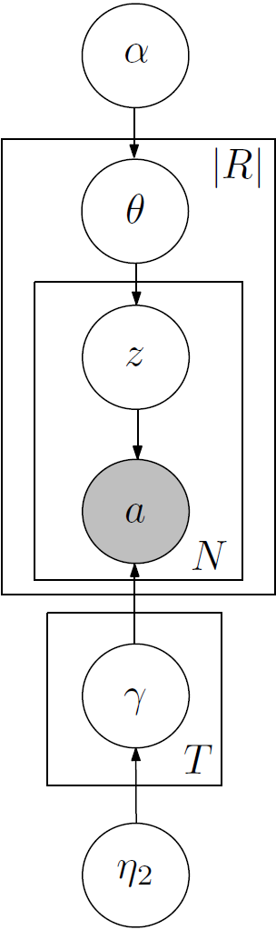

Distant Supervision with Latent Variables
[Ritter et. al. EMNLP 2011]
Applying DS directly to NER doesn’t work
Training data is too ambiguous…
Proposed solution:
Latent Variable Models for Named Entity Categorization
With constraints
[Ramage et. al. 2009]

Slide 32
Distant Supervision with Latent Variables
[Ritter et. al. EMNLP 2011]
Obama
Apple
JFK
On my way to JFK early in the…
JFK 's bomber jacket sells for…
JFK Airport’s Pan Am Worldport…
Waiting at JFK for our ride…
When JFK threw first pitch on…
X
…
Entity Types:
‘s 0.04
threw 0.02
jacket 0.01
…
waiting 0.04
ride 0.03
way 0.02
…
announced 0.04
new 0.03
release 0.02
…
PERSON
FACILITY
PRODUCT

Slide 33
Distant Supervision with Latent Variables
[Ritter et. al. EMNLP 2011]
Obama
Apple
JFK
On my way to JFK early in the…
JFK 's bomber jacket sells for…
JFK Airport’s Pan Am Worldport…
Waiting at JFK for our ride…
When JFK threw first pitch on…
X
…
…
Entity Types:
‘s 0.04
threw 0.02
jacket 0.01
…
waiting 0.04
ride 0.03
way 0.02
…
announced 0.04
new 0.03
release 0.02
…
PERSON
FACILITY
PRODUCT

Slide 34
Data/Inference
Gather entities and words which co-occur
Extract Entities from about 60M status messages
Used a set of 10 types from Freebase
Commonly occur in Tweets
Good coverage in Freebase
Inference: Collapsed Gibbs sampling:
Constrain types using Freebase
For entities not in Freebase, don’t constrain

Slide 35
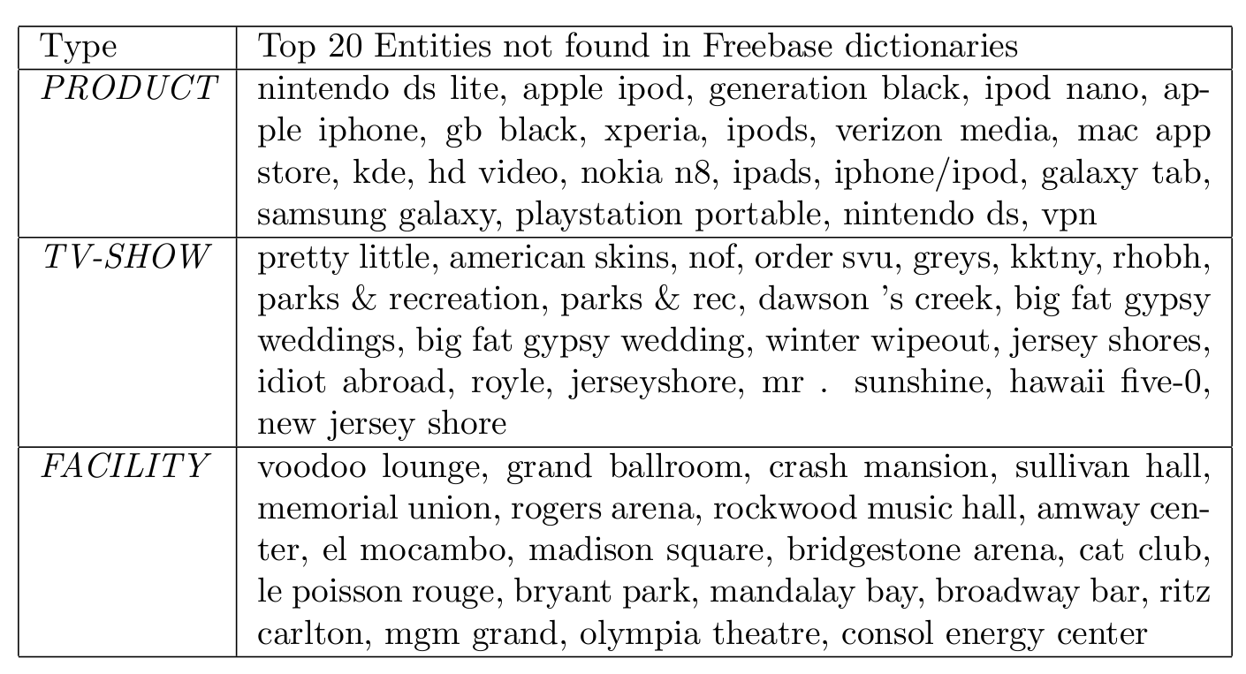
Type Lists

Slide 36
Type Lists
KKTNY = Kourtney and Kim Take New York
RHOBH = Real Housewives of Beverly Hills

Slide 37
Classification Results: 10 Types
25% increase in F1
[Collins and Singer 1999]

Slide 38
Why is LDA winning?
Share type info. across mentions
“KKTNY in 45 min…”
“Watching KKTNY tonight on TV”
Explicitly models ambiguity
Each “entity string” is modeled as (constrained) distribution over types
Takes better advantage of ambiguous training data
Ambiguous
TV Show

Slide 39
Distant Supervision: A Natural Question
What about missing data?
Leads to errors in the training data
General problem:
Affects both NER and Binary relations
Binary Relations →
Lots of overlapping / highly correlated features
E.g. dependency paths, word sequences, etc…
Conditional Models are better
Don’t make bad independence assumptions

Slide 40
Missing Data in Distant Supervision
e.g. [Mintz et. al. 2009]
(Albert Einstein, Ulm)
(Mitt Romney, Detroit)
(Barack Obama, Honolulu)
Person | Birth Location
Barack Obama | Honolulu
Mitt Romney | Detroit
Albert Einstein | Ulm
Nikola Tesla | Smiljan
… | …
“Barack Obama was born on August 4, 1961 at … in the city of Honolulu ...”
“Birth notices for Barack Obama were published in the Honolulu Advertiser…”
“Born in Honolulu, Barack Obama went on to become…”
…

Slide 41
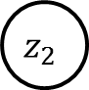
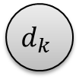

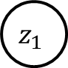

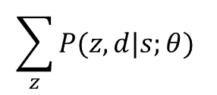
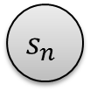
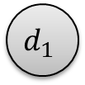

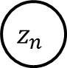

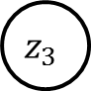
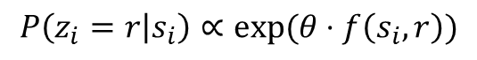
MultiR (Binary Relations)
[Hoffmann et. al. 2011]
(Barack Obama, Honolulu)
$$s_{1}$$
$$s_{2}$$
$$s_{3}$$
…
$$s_{n}$$
Sentences
Local Extractor
$$P\left(z_{i}=r | s_{i}\right)∝exp⁡(θ⋅f\left(s_{i},r\right))$$
$$z_{1}$$
$$z_{2}$$
$$z_{3}$$
…
$$z_{n}$$
Relation mentions
Deterministic OR
$$d_{1}$$
$$d_{2}$$
…
$$d_{k}$$
Aggregate Relations
Maximize
Conditional
Likelihood
(Born-In, Lived-In, children, etc…)
$$\sum_{z}{P(z,d|s;θ) }$$

Slide 42
Learning
Structured Perceptron (gradient based update)
MAP-based learning
Online Learning
$\frac{∂{log⁡O}_{i}(θ)}{∂θ}=E_{p\left(z | s,d;θ\right)}\left(\sum_{j}{f(s_{j},z_{j}) }\right)$ - $E_{p\left(d,z | s;θ\right)}\left(\sum_{j}{f(s_{j},z_{j}) }\right)$
$\frac{∂{log⁡O}_{i}(θ)}{∂θ}≈\max_{p\left(z | s,d;θ\right)}\left(\sum_{j}{f(s_{j},z_{j}) }\right)$ - $\max_{p\left(d,z | s;θ\right)}\left(\sum_{j}{f(s_{j}, z_{j}) }\right)$
Max assignment to Z’s (conditioned on Freebase)
Weighted Edge Cover Problem
(can be solved exactly)
Max assignment to Z’s (unconstrained)
Trivial

Slide 43
Missing Data Problems…
2 Assumptions Drive learning:
Not in DB -> not mentioned in text
In DB -> must be mentioned at least once
Leads to errors in training data:
False positives
False negatives

Slide 44

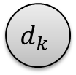

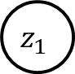
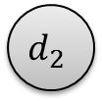





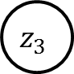
Changes
$$s_{1}$$
$$s_{2}$$
$$s_{3}$$
…
$$s_{n}$$
$$z_{1}$$
$$z_{2}$$
$$z_{3}$$
…
$$z_{n}$$
$$d_{1}$$
$$d_{2}$$
…
$$d_{k}$$

Slide 45
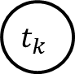
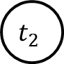
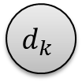
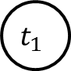


Modeling Missing Data
$$s_{1}$$
$$s_{2}$$
$$s_{3}$$
…
$$s_{n}$$
$$z_{1}$$
$$z_{2}$$
$$z_{3}$$
…
$$z_{n}$$
Mentioned in Text
$$t_{1}$$
$$t_{2}$$
…
$$t_{k}$$
Encourage Agreement
Mentioned in DB
$$d_{1}$$
$$d_{2}$$
…
$$d_{k}$$

Slide 46
Learning
Old parameter updates:
$\frac{∂{log⁡O}_{i}(θ)}{∂θ}=\max_{p\left(z | s,d;θ\right)}\left(\sum_{j}{f(s_{j},z_{j}) }\right)$ - $\max_{p\left(d,z | s;θ\right)}\left(\sum_{j}{f(s_{j}, z_{j}) }\right)$
Doesn’t make much difference…
New parameter updates (Missing Data Model):
$\frac{∂{log⁡O}_{i}(θ)}{∂θ}=\max_{p\left(t,z | s,d;θ\right)}\left(\sum_{j}{f(s_{j},z_{j}) }\right)$ - $\max_{p\left(t,d,z | s;θ\right)}\left(\sum_{j}{f(s_{j}, z_{j}) }\right)$
This is the difficult part!
soft constraints
No longer weighted edge-cover

Slide 47
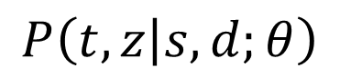
MAP Inference
Aggregate “mentioned in text”
Sentence level hidden variables
Sentences
Database
Find z that maximizes
Optimization with soft constraints
A* Search
Exact, but doesn’t scale to large problems
Local search almost always optimal
With carefully chosen search operators
In ~100,000 problems only missed an optimal solution 3 times.
(Compared with optimal solution found using A*)
On problem sizes up to 100 variables (covers most of the data)
Time and memory efficient
$$P\left(t,z | s,d;θ\right)$$

Slide 48
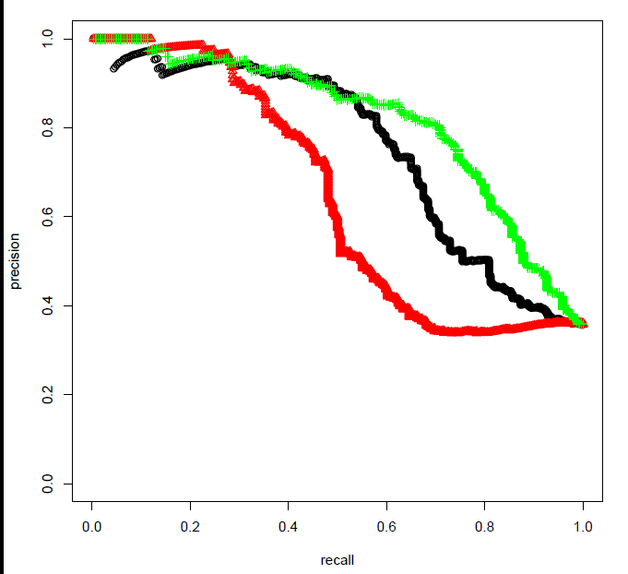
Experiments
Red: MultiR
Black: Soft Constraints
Green: Missing Data Model
[Hoffmann et. al. 2011]

Slide 49
Contributions
IE In Informal Text
Analysis of challenges in informal text
Adapted NLP tools to Twitter
http://github.com/aritter/twitter_nlp
Calendar Demo
http://statuscalendar.cs.washington.edu/
Probabilistic Models of Open Domain IE
Unsupervised Event Categorization
Distant Supervision using Topic Models
Modeling missing data in Distant Supervision

Slide 50


Other Themes
Conversational Modeling in Social Media
[Ritter, Cherry, Dolan, NAACL 2010]
[Ritter, Cherry, Dolan, EMNLP 2011]
Paraphrasing Between Language Styles
[Xu, Ritter, Dolan, Grishman, Cherry, COLING 2012]
[Xu, Ritter, Grishman, In Submission.]

Slide 51
Approach: Statistical Machine Translation
[Ritter, Cherry, Dolan, EMNLP 2011]
 | SMT | Response Generation
INPUT: | Foreign Text | User Utterance
OUTPUT | English Text | Response
TRAIN: | Parallel Corpora | Conversations

Slide 52
Approach: Statistical Machine Translation
[Ritter, Cherry, Dolan, EMNLP 2011]
 | SMT | Response Generation
INPUT: | Foreign Text | User Utterance
OUTPUT | English Text | Response
TRAIN: | Parallel Corpora | Conversations

Slide 53
Phrase-Based Translation
STATUS:
[Ritter, Cherry, Dolan, EMNLP 2011]
who wants to come over for dinner tomorrow?
RESPONSE:

Slide 54
Phrase-Based Translation
STATUS:
[Ritter, Cherry, Dolan, EMNLP 2011]
who wants to come over for dinner tomorrow?
RESPONSE:
Yum ! I
Notes:
-Use Moses phrase-based decoder

Slide 55
Phrase-Based Translation
STATUS:
[Ritter, Cherry, Dolan, EMNLP 2011]
who wants to come over for dinner tomorrow?
RESPONSE:
Yum ! I
want to

Slide 56
Phrase-Based Translation
STATUS:
[Ritter, Cherry, Dolan, EMNLP 2011]
who wants to come over for dinner tomorrow?
RESPONSE:
Yum ! I
want to
be there

Slide 57
Phrase-Based Translation
STATUS:
[Ritter, Cherry, Dolan, EMNLP 2011]
who wants to come over for dinner tomorrow?
RESPONSE:
Yum ! I
want to
be there
tomorrow !

Slide 58
Demo
www.cs.washington.edu/homes/aritter/mt_chat.html

Slide 59
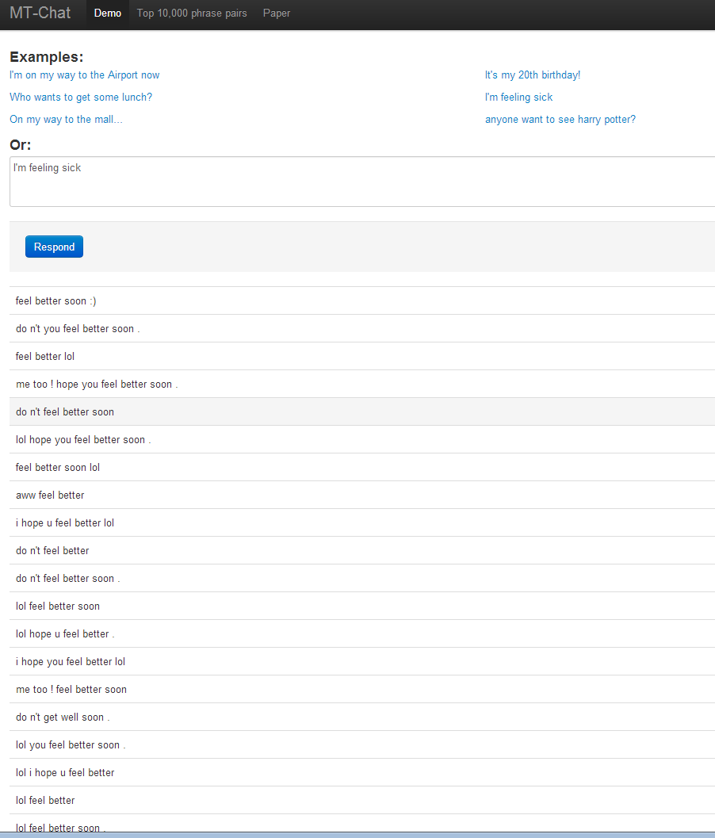

Slide 60
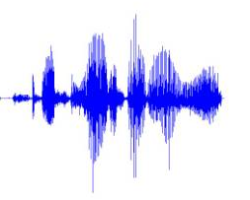
Data Driven Response Generation: Potential Applications
[Ritter, Cherry, Dolan, EMNLP 2011]
Conversationally-aware predictive text entry
Speech Interface to SMS/Twitter (Ju and Paek 2010)
Status:
Response:
Response:
I’m feeling sick
=
Hope you feel better
+

Slide 61
Other Themes
Conversational Modeling in Social Media
[Ritter, Cherry, Dolan, NAACL 2010]
[Ritter, Cherry, Dolan, EMNLP 2011]
Paraphrasing Between Language Styles
[Xu, Ritter, Dolan, Grishman, Cherry, COLING 2012]

Slide 62


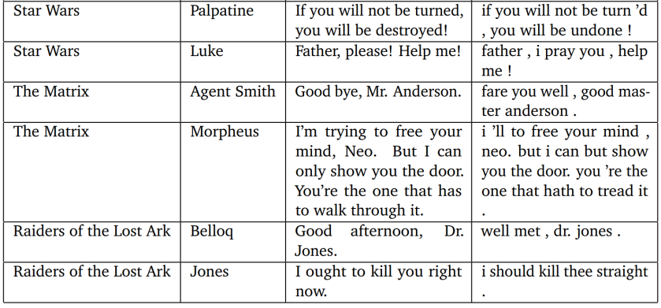
Shakespearean Paraphrasing
[Xu, Ritter, Dolan, Grishman, Cherry, COLING 2012]
Approach: use modern translations as parallel text
Father, please! Help me!
--------------------------------
Father, I pray you, help me!
If you will not be turned you will be destroyed!
--------------------------------
If you will not be turn’d, you will be undone!

Slide 63
Paraphrasing Language Styles
[Xu, Ritter, Dolan, Grishman, Cherry, COLING 2012]
Educational Applications
Allow students to access modern English versions
modern translations: Only 17 out of 38 plays
Other Elizabethan authors…
Other Domains
Paraphrasing technical documents
Informal => Formal

Slide 64
Future Work: Richer Semantics from Microblogs
Clustering Events (Event Reference Resolution)
Group Tweets which refer to the same event
Group Named entities involved in the same event
Schema Discovery
Induce Roles for each type
Classify entities into roles
Concert:
Music Artist
City
Venue

Slide 65


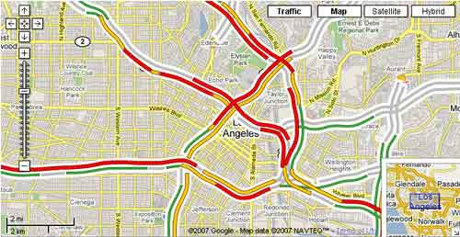

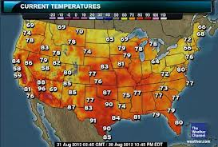

Future Work: Real-World Language Grounding

Slide 66
Proposed Approach
Latent Variable Models
Extend to to incorporate realtime text + sensor data
Find links between events text + sensors
Ground the meaning of distributional semantics in real-world sensor data.

Slide 67

Collaborators
Doug Downey
Oren Etzioni
Emily Fox
Mausam
Stephen Soderland
Luke Zettlemoyer
…
Sumit Basu
Chris Burges
Colin Cherry
Bill Dolan
...
Wei Xu
Ralph Grishman
Thanks!

